Slide 1
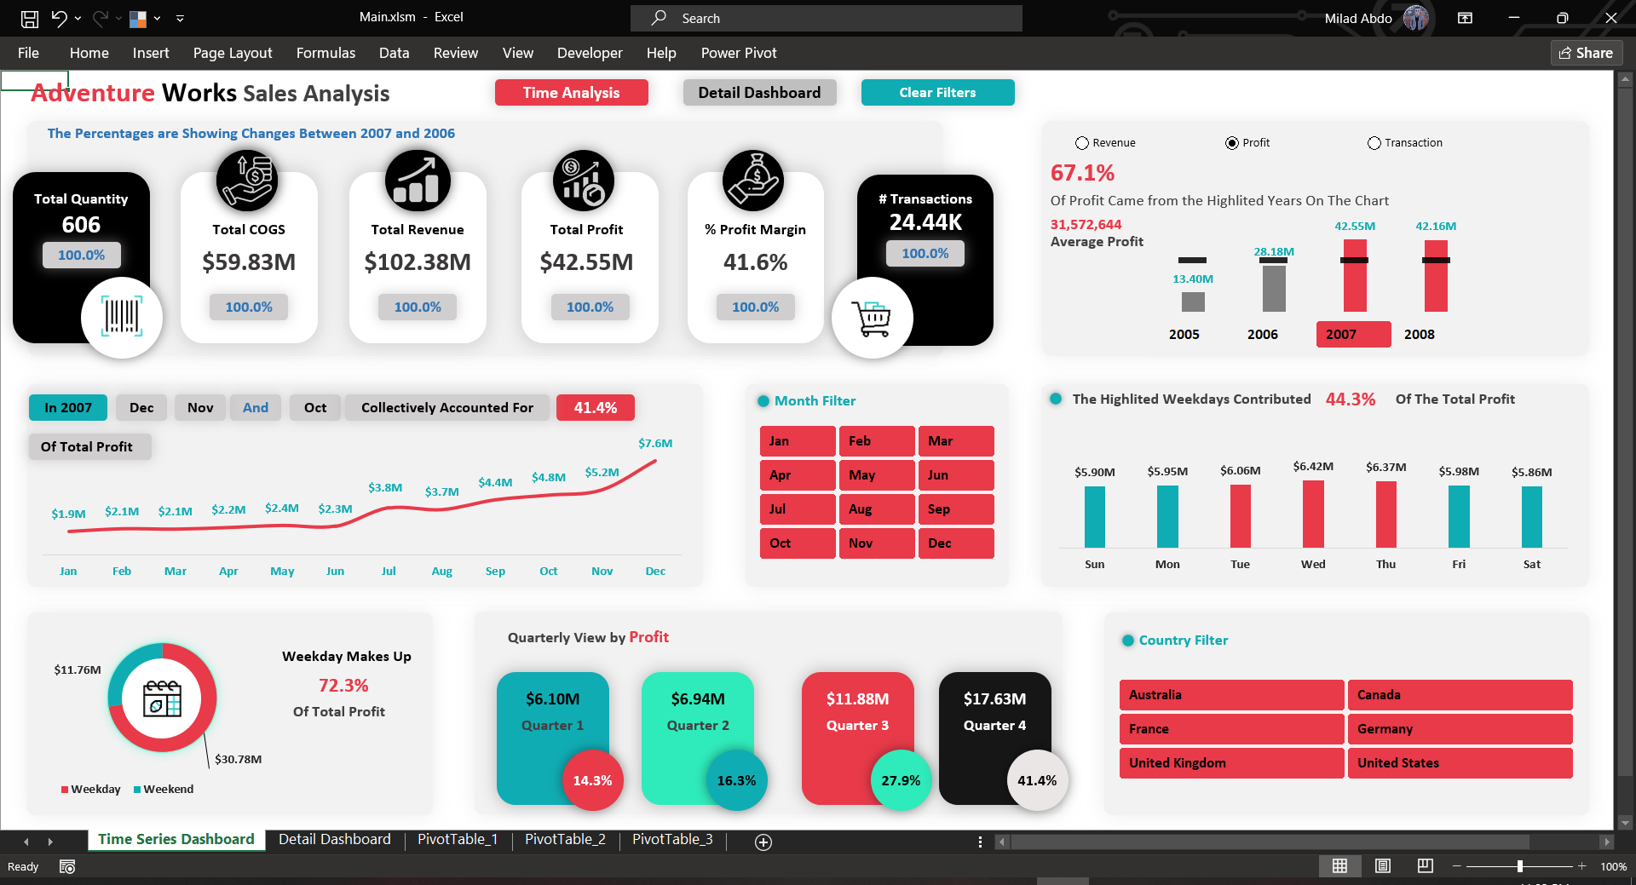

Slide 2
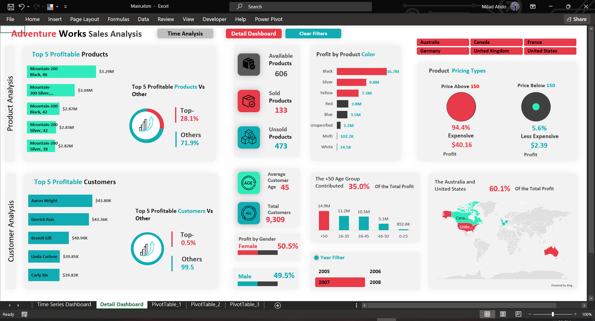

Slide 3
Adventure Works Sales
I’ve just completed an in-depth analysis of product sales data, and I’m eager to share the insights and learnings from this project. Here are some highlights:
📊 Objectives:
Identify sales trends and patterns across different regions and time periods
Analyze factors influencing product performance
Provide actionable insights to optimize sales strategies

Slide 4
Tools Used
Excel
And Used a Macro Record for Clear filters
Power Query to connect with the data and transform it
Create Some conditional Columns And Calculation Table for All necessary Calculations
Remove Unused Columns from each Table

Slide 5
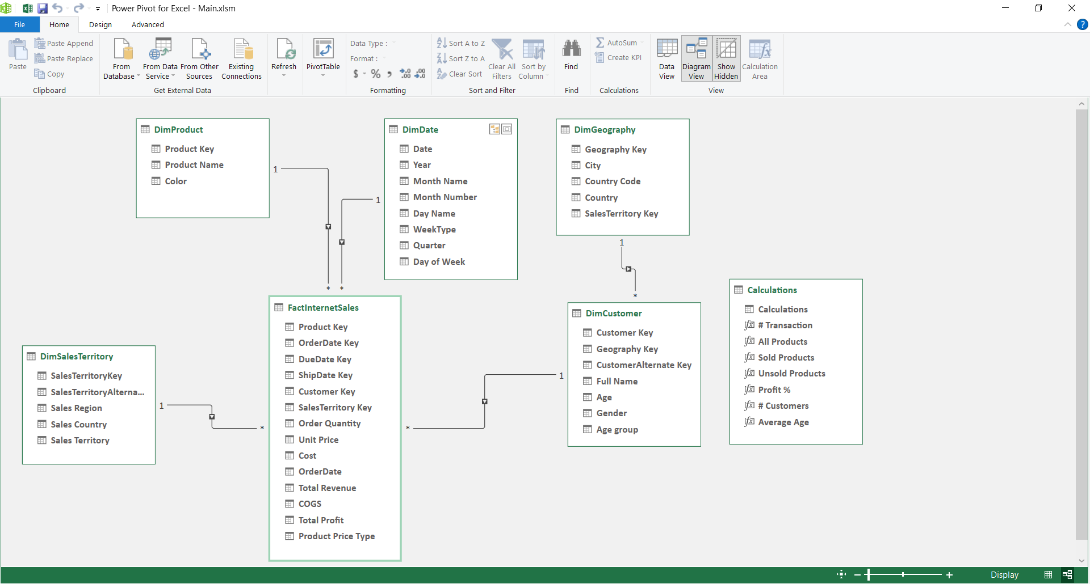
The Dataset diagram view and Relationships

Slide 6
Time Analysis Dashboard
1. KPI Comparison to Previous Year:
COGS, Revenue, Quantity, Profit, Profit Margin, and Transaction compared to the previous year.
2. Yearly Performance Metrics (Above Average Years):
Total Revenue, Profit, and Transaction for years exceeding the average performance.
3. Monthly Profit Trends:
Analyzing profit trends on a monthly basis.
4. Profit by Week Type:
Assessing profit based on different week types.

Slide 7
5. Quarterly Profit Analysis:
Evaluating profit performance on a quarterly basis.
6. Profit by Weekday:
Examining profit trends specific to weekdays.

Slide 9
Details Dashboard
Product analysis
1. Top 5 Profitable Products (% Contribution and Others):
Identifies the five most profitable products and their contribution as a percentage of total profits, with insights into the rest.
2. Profit by Product Color (Highlighting Best Sellers):
Analyzes profits associated with product colors, highlighting the best-selling colors for optimization.
3. Profit by Pricing Types:
Examines profit variations based on pricing types, providing insights into pricing strategy effectiveness.

Slide 10
Details Dashboard
Customer analysis
1. Top 5 Profitable Customers (% Contribution and Others):
Highlights the top five high-profit customers, their percentage share of overall profits, and details about other customers' contributions.
2. Profit by Gender:
Displays profit breakdown by gender, helping identify gender-based profit trends.
3. Profit by Age Groups:
Segments profits into age groups to understand which age demographics contribute the most to profitability
Country-wise Profit (Custom Map):
Utilizes a custom map to visualize profit distribution by country, aiding in geographic targeting.

